Slide 1


LMTracer: Fine-Grained and Real-Time Performance Profiling for Production LLM Systems
Wei Liu, Yongchao He, Bohan Zhao, Hongyi Wang, Zhenhua Li, Junping Zhao
Speaker: Kun Qian
Notes:
OK, thanks for the introduction. Good morning, everyone. Today, I’m going to present our work: LMTracer: Fine-Grained and Real-Time Performance Profiling for Production LLM Systems.
I’m Kun Qian. The authors couldn’t be here today, so I’m presenting on their behalf.
Let me start with some background.

Slide 2
Outline
Background
Motivation
Design
Evaluation
Conclusion

Slide 3
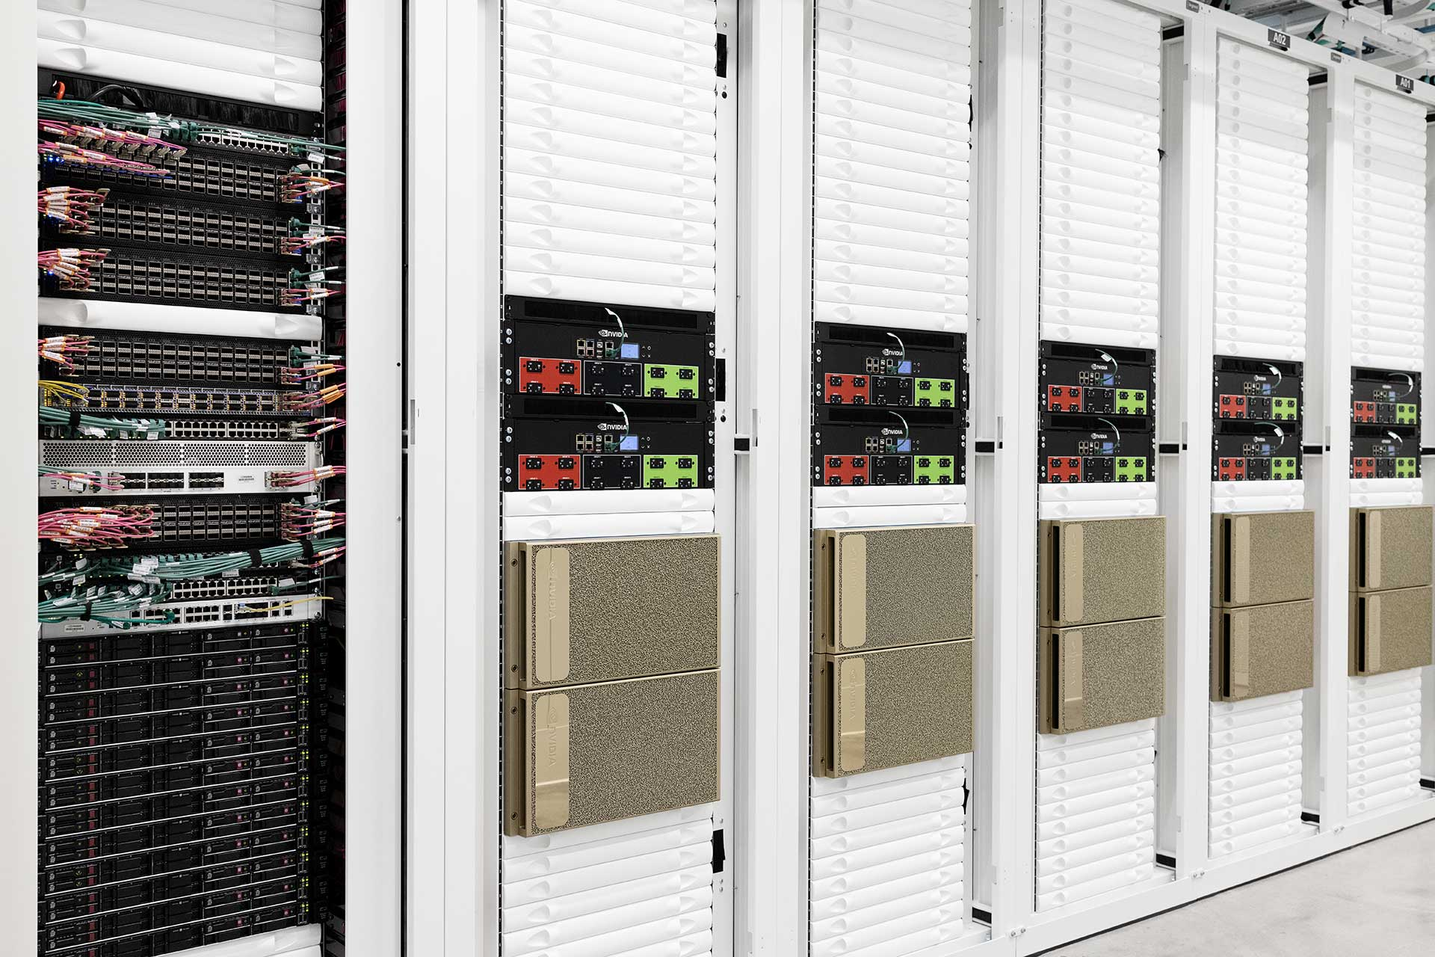
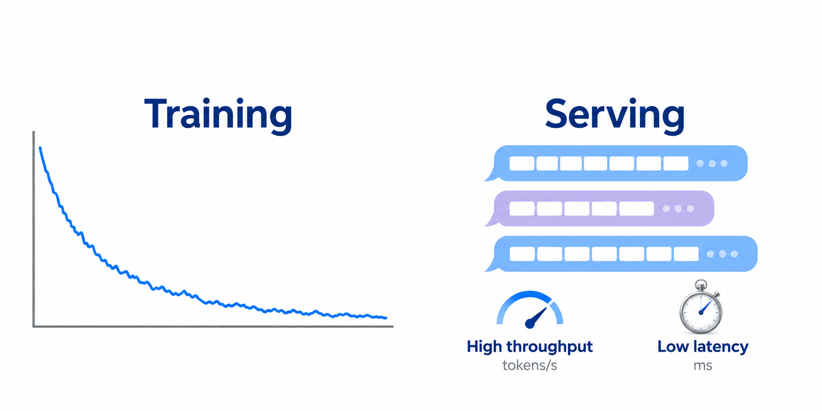
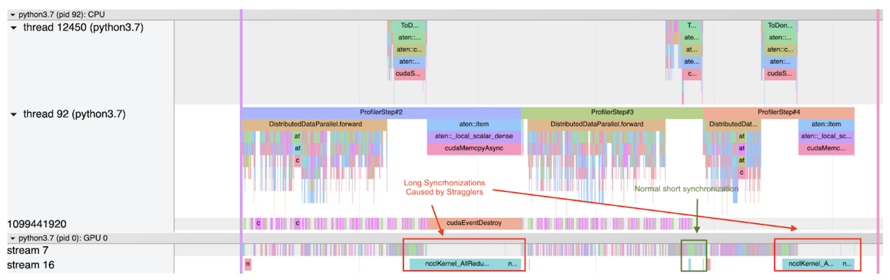
1. Background
LLM training and serving are core workloads on the cloud
  Training uses thousands of GPUs for weeks or months
  Serving demands high throughput and low latency
  Performance bottlenecks raise costs and hurt user experience
Large-scale GPU infrastructure
Needs for high throughput and low latency
Ensuring QoE through profiling
Notes:
LLM training and serving are core workloads in today’s cloud service providers.
Training large models can occupy thousands of GPUs for weeks or months, so even a small loss in efficiency can waste substantial resources.
Serving has a different requirement: it must deliver high throughput while keeping response latency low. Performance bottlenecks therefore have two direct consequences. They increase infrastructure costs, and they degrade the experience of users waiting for responses.

Slide 4


1. Background
Profiling matters, yet existing tools fall short
Telemetry-based monitoring
Kernel-level profiling
Throughput, iteration time, etc.
LLM framework metrics and eBPF
Measured mostly on CPUs
Measuring execution times of GPU kernels
Nsight Systems and PyTorch Profiler
Measured on GPUs
Lightweight but coarse-grained
Fine-grained but intrusive
Notes:
As a result, online profiling is essential for identifying performance bottlenecks or potential issues in production LLM systems.
Existing approaches fall into two categories. Telemetry-based monitoring aggregates high-level performance metrics, such as token throughput, iteration time, and request latency.
They are often available in LLM frameworks like vLLM, SGLang, and Megatron. It is lightweight, but provides limited insight into the GPU execution time of individual LLM components.
Kernel-level profilers, such as NVIDIA Nsight Systems and PyTorch Profiler, capture detailed GPU traces, but introduce substantial overhead in production because they can disrupt asynchronous GPU execution.

Slide 5
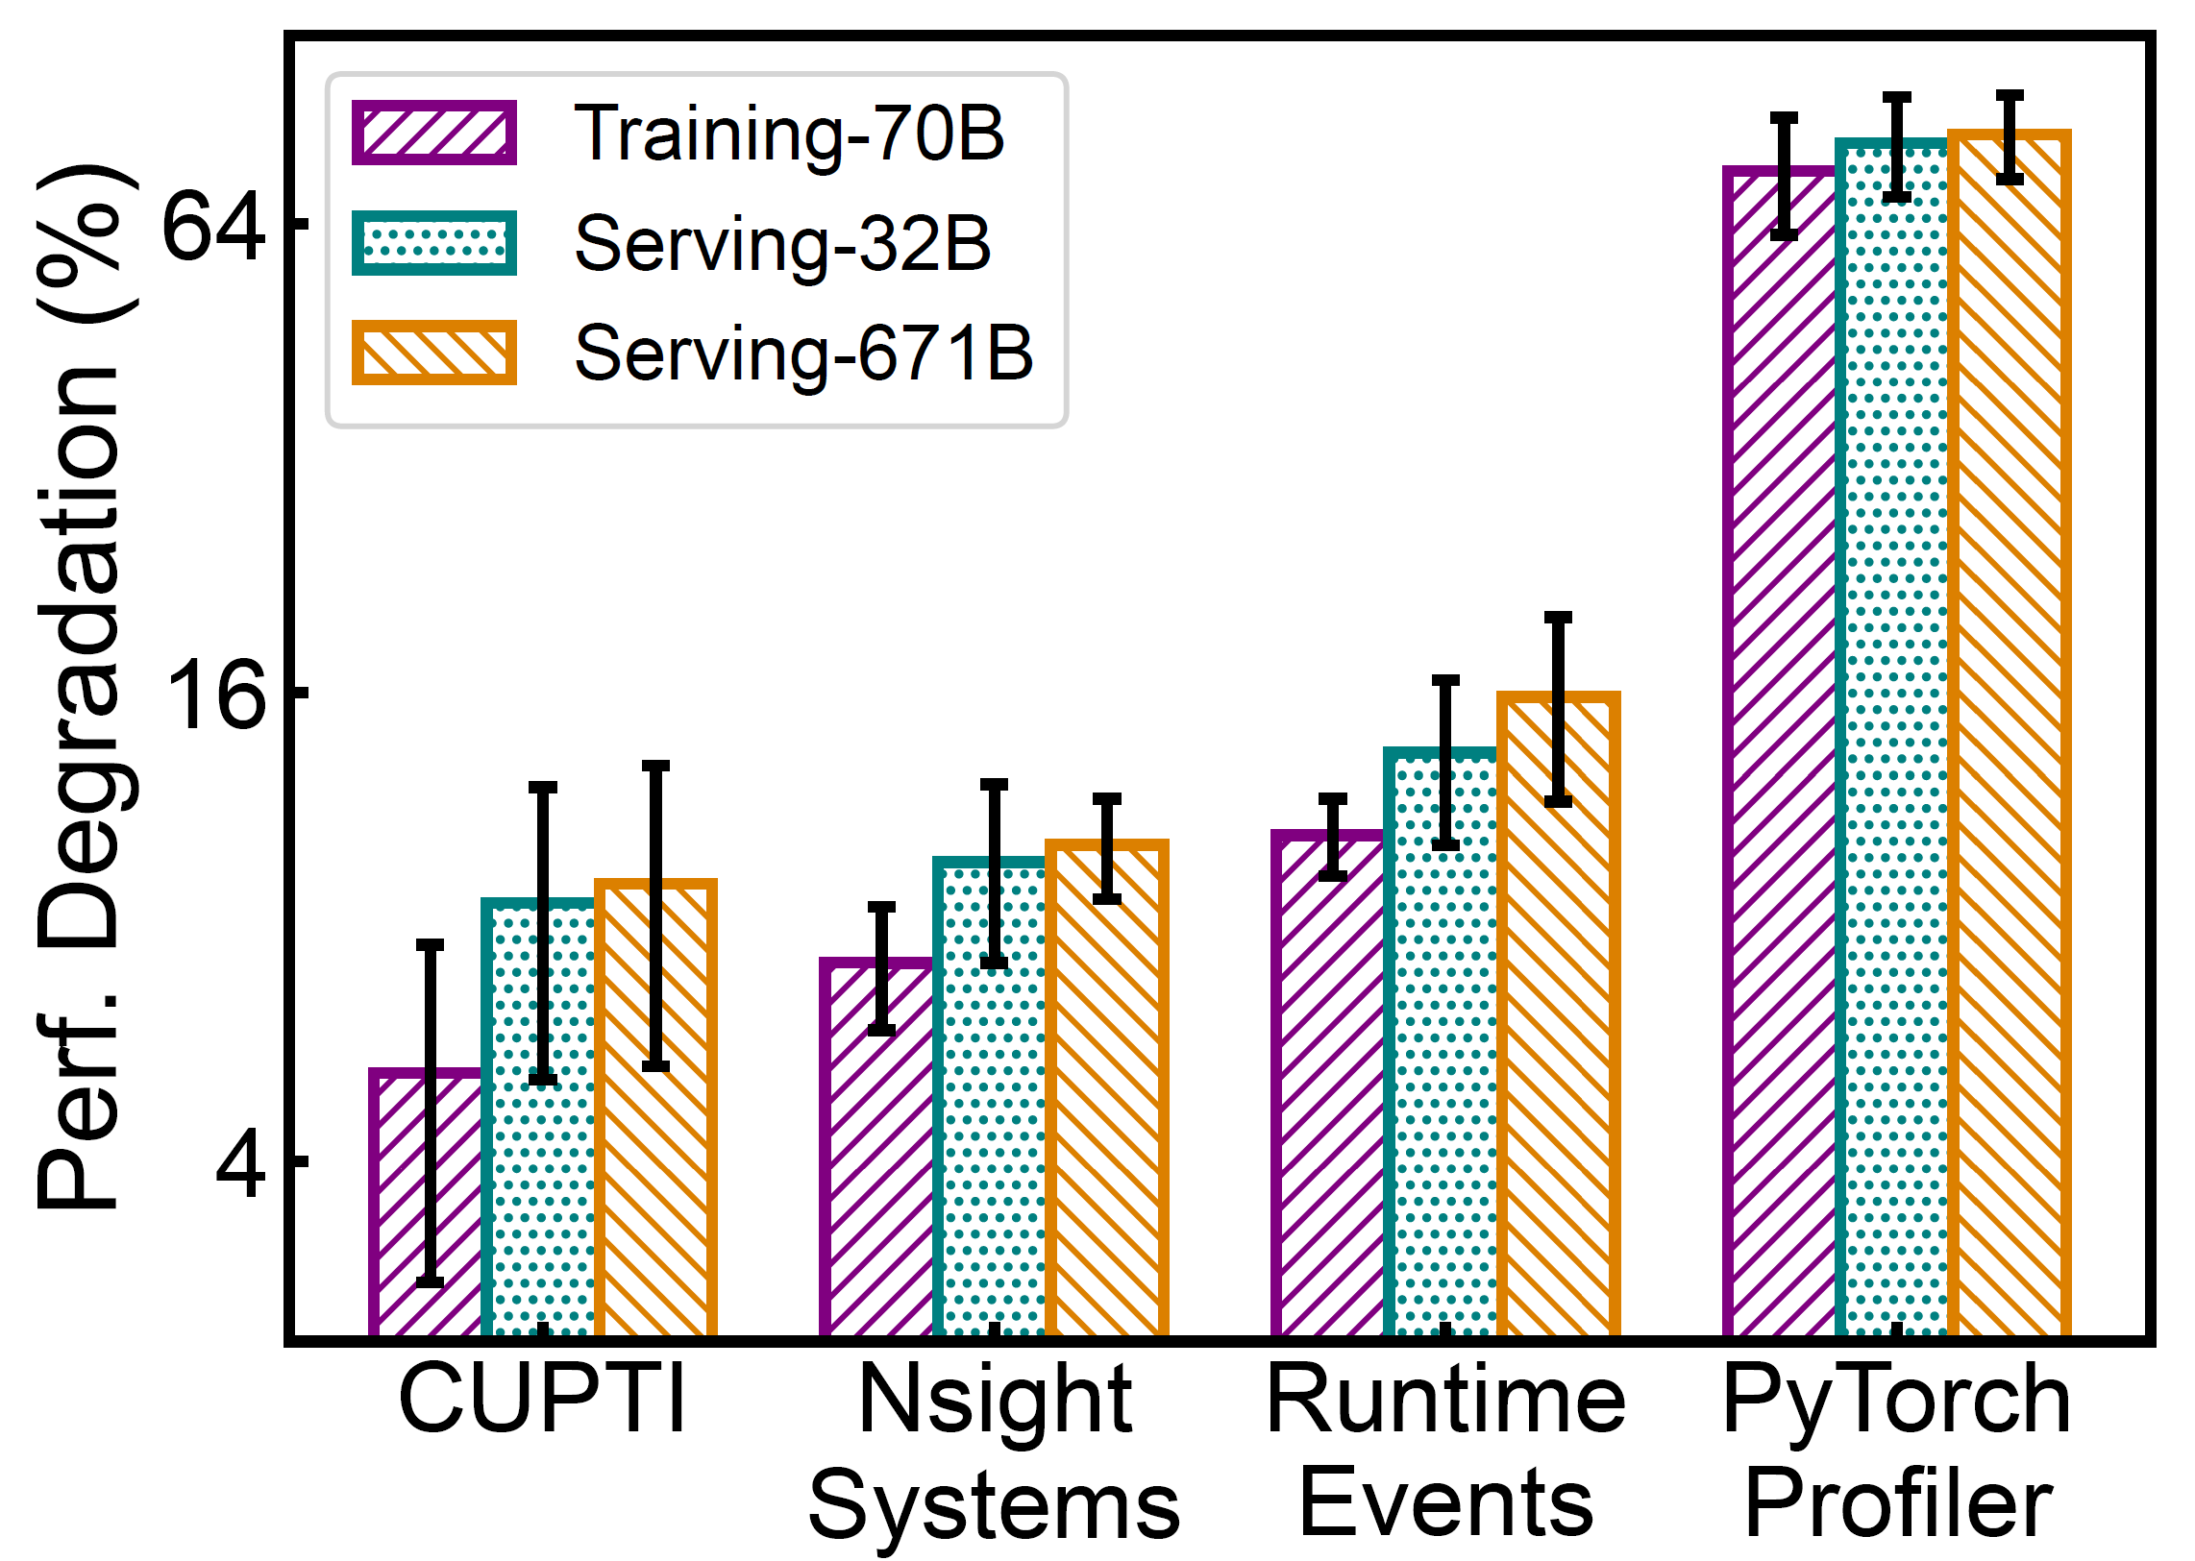
2. Motivation
Kernel-level profilers impose substantial overhead
  Nsight Systems increases training iteration time by 7.2%
  PyTorch Profiler reduces serving throughput by 83.4%
  Such overhead limits real-time performance profiling in production
Notes:
As shown here, Nsight Systems increases iteration time by seven point two percent when training a 70B model. PyTorch Profiler decreases token throughput by 83.4 percent in LLM serving. Such performance degradation limits their applicability to real-time profiling in production.

Slide 6
2. Motivation
Kernel-level profiling disrupts asynchronous execution
Without profiling
CPU submits ahead
CPU
K1
K2
K3
GPU
K1
K2
K3
With synchronization-based profiling
CPU
K1
Wait
Read
K2
Wait
Read
K3
GPU
K1
Idle
K2
Idle
K3
Added execution time
Time
CPU blocks: kernel launches
Notes:
We examine how these kernel-level profilers interact with GPUs when LLM workloads are running. To minimize idle time, GPUs employ an asynchronous execution model.
As shown in the upper timeline, the CPU issues kernels in a non-blocking manner[点击1], submitting work ahead while the GPU executes queued kernels[点击2].
However, profiling can interrupt this execution flow with synchronization barriers[点击3]. In the lower timeline, the CPU waits for GPU execution to complete before reading timing data. This delays subsequent kernel launches, introduces GPU idle time, and thus increases the overall execution time.

Slide 7
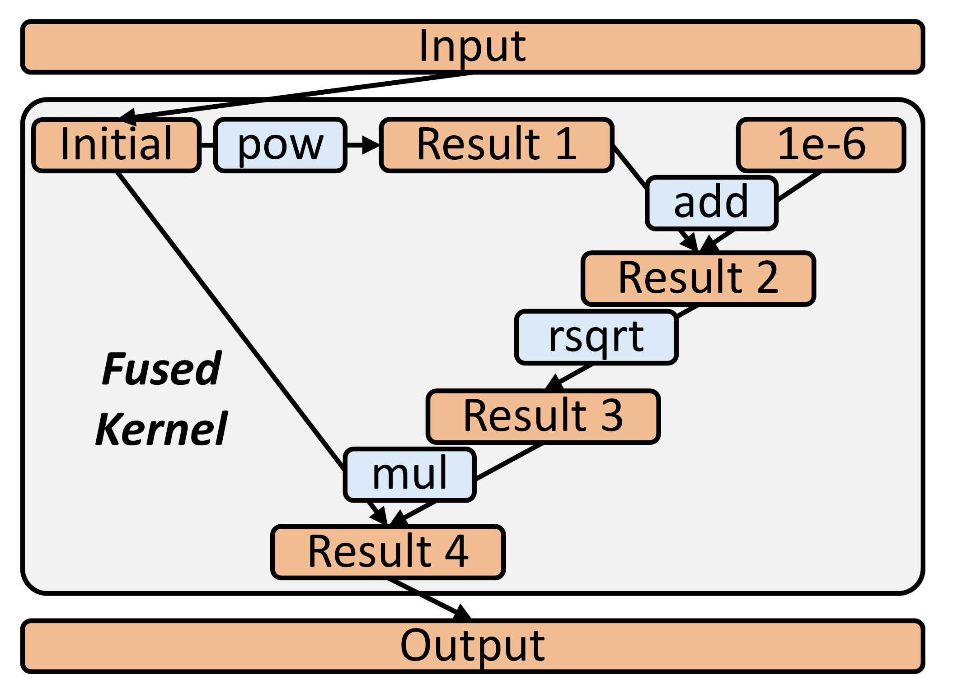

2. Motivation
Kernel-level profilers impose substantial overhead
  CUDA events can record timestamps asynchronously
  Unsupported profiling operations can trigger graph breaks
  Graph breaks limit kernel fusion and introduce extra kernel launches
Graph breakage
CUDA events
Graph execution
Notes:
So, some may think that we can use CUDA events to record timestamps asynchronously and avoid this synchronization overhead. However, LLM frameworks also rely on kernel fusion and graph execution to reduce GPU idle time[点击1]. As illustrated here, inserting unsupported profiling operations like CUDA Events[点击2] can trigger graph breaks[点击3], limiting kernel fusion and introducing extra kernel launches.

Slide 8
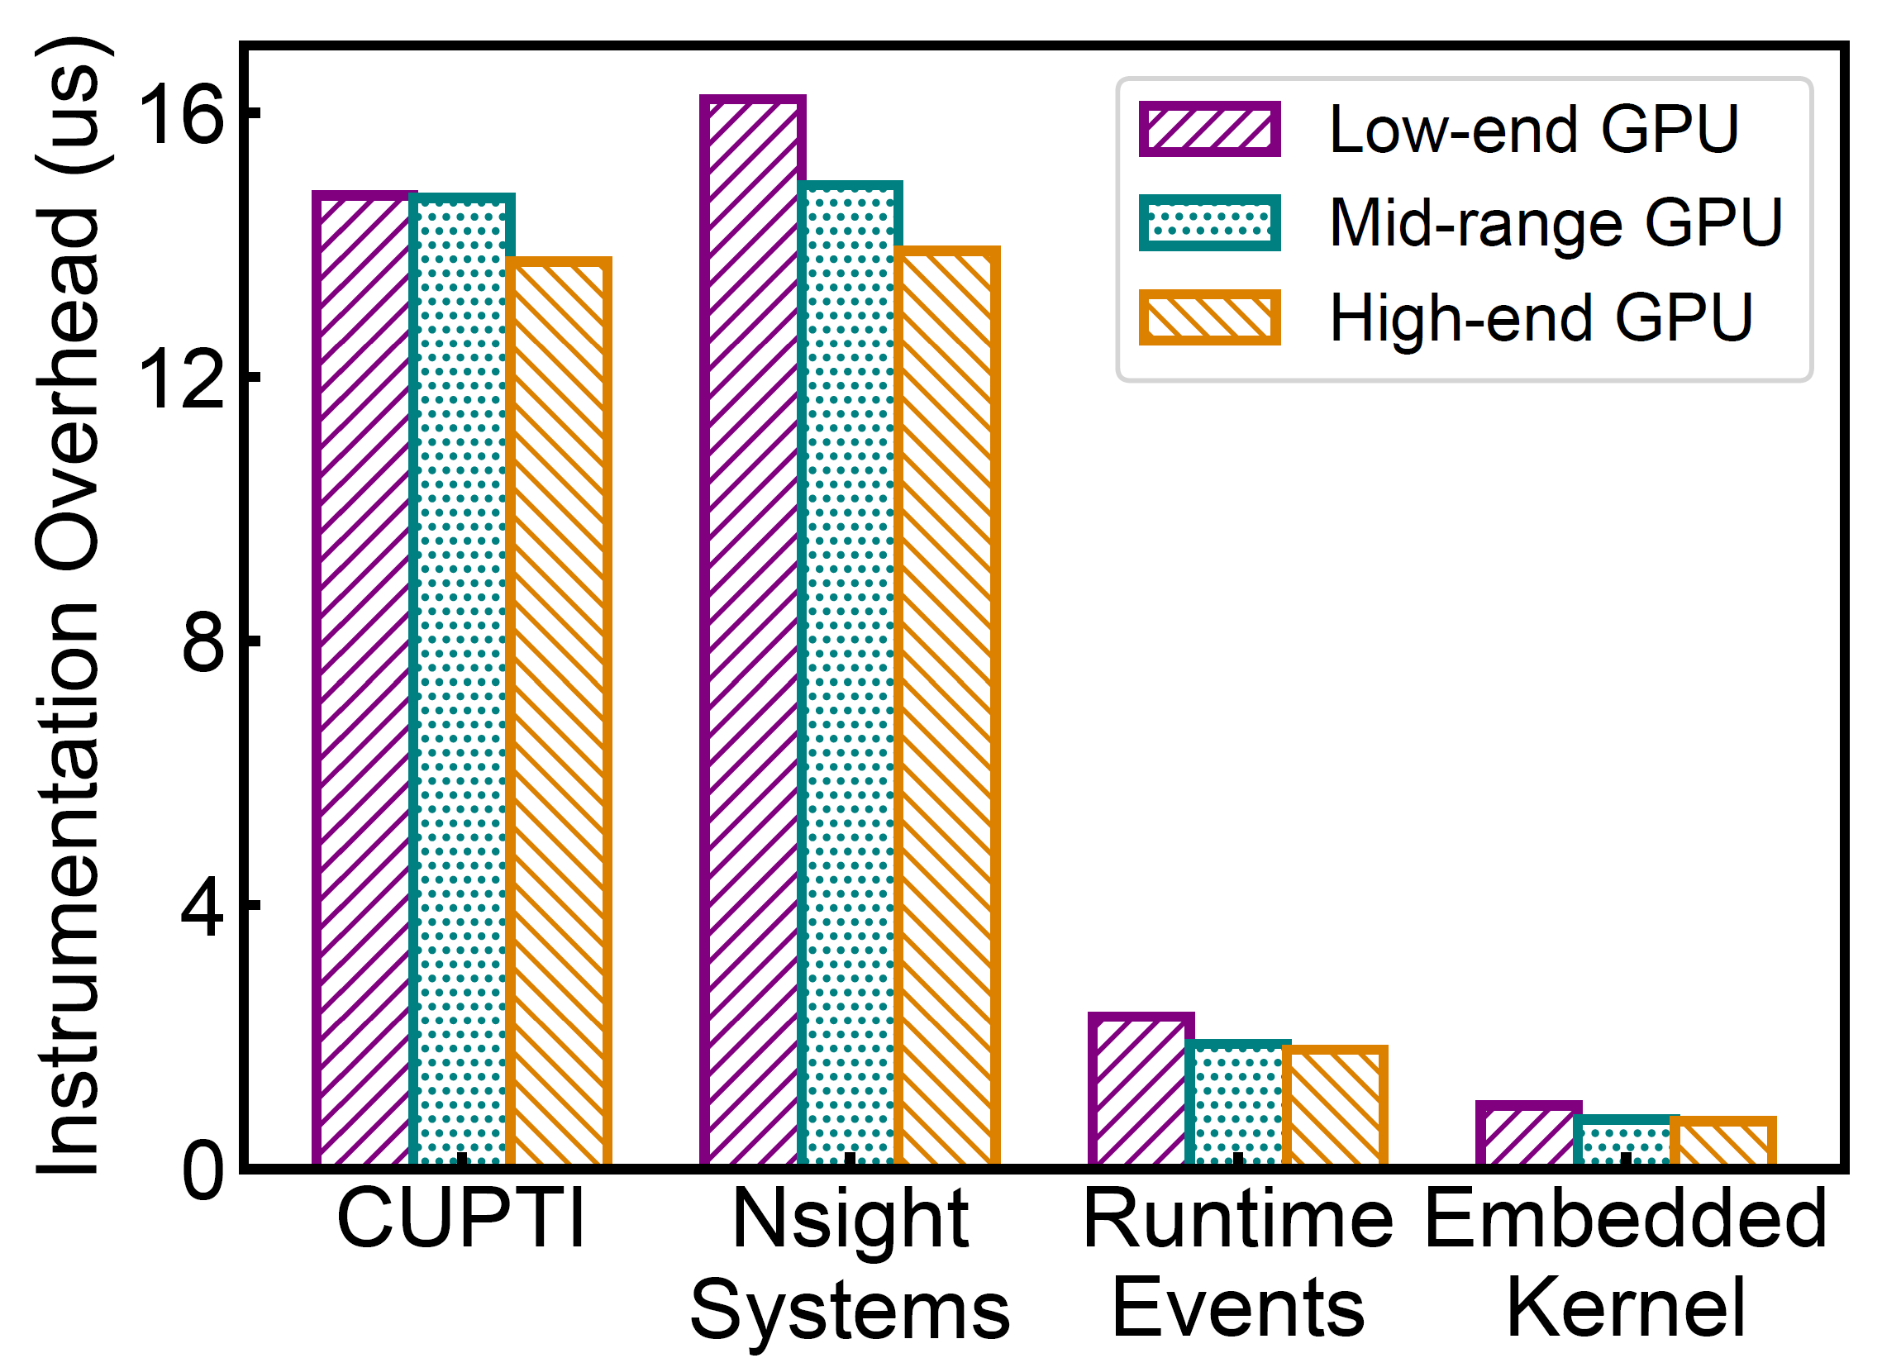
2. Motivation
Kernel-level profilers impose substantial overhead
  Overhead per trace point across profilers
CUPTI and Nsight Systems
  ~14–16 μs per trace point
Runtime events
  Reduce overhead to ~2 μs (but can break graph executions)
Embedded kernels to read GPU clock registers
  Achieve ~1 μs or less
Notes:
We measure the instrumentation overhead introduced by each trace point under different profiling methods. As shown here, Nsight Systems incur around fourteen to sixteen microseconds of each trace point on average[点击1], while runtime events reduce this to around two microseconds but can disrupt graph execution[点击2].
However[点击3], we also find that if we launch special kernels to read the GPU clock register before and after certain operations, we can measure their execution time with about one microsecond or less of overhead per trace point.

Slide 9
2. Motivation
Kernel-level profilers impose substantial overhead
  Probe kernels embedded in CUDA Graphs to read GPU clock registers
  Low-overhead because kernels are the basic execution units on GPUs
  By reading the globaltimer register for NVIDIA GPUs or invoke the s_memtime instruction for AMD GPUs
Opportunity
Implement profiling logic as lightweight GPU kernels
Notes:
This is because GPU kernels are the basic execution units on GPUs. These special probe kernels can be captured in CUDA graphs and execute in order with the workload kernels, without requiring the CPU to wait for each timing measurement.
[点击1]
Reading clock registers can be achieved by reading the globaltimer register for NVIDIA GPUs or invoke the memtime instruction for AMD GPUs.
[点击2]
So this provides us with an opportunity to embed profiling logic directly into GPU execution graphs with minimal profiling overhead.

Slide 10
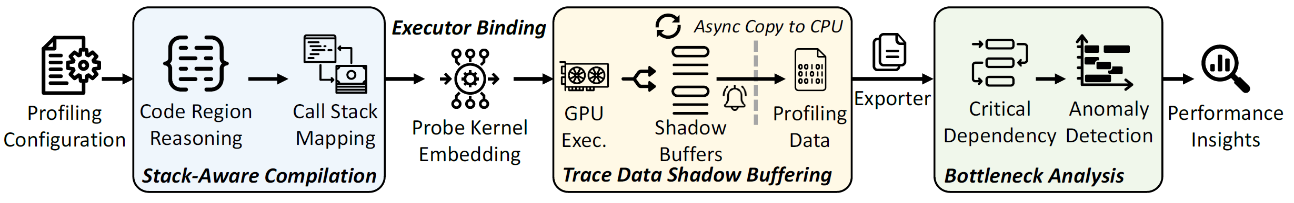
3. Design of LMTracer
LMTracer: Graph-embedded probing
  Implement profiling logic as lightweight probe kernels
  Preserve kernel fusion when embedding probes
  Stream trace data to CPUs asynchronously
Architectural overview of LMTracer
Notes:
With this idea, we build LMTracer, a lightweight LLM profiling framework through graph-embedded probing.
Let me walk you through the overview. Starting from the left, users specify which code regions they want to profile. We then use stack-aware compilation to map those regions to GPU kernels and insert probe kernels without breaking kernel fusion.
During execution, the probe kernels write timing data into shadow buffers on the GPU. We copy that data to the CPU asynchronously, while the workload keeps running. Finally, we use the collected traces to identify performance bottlenecks.
Let us first look at how developers use LMTracer.

Slide 11
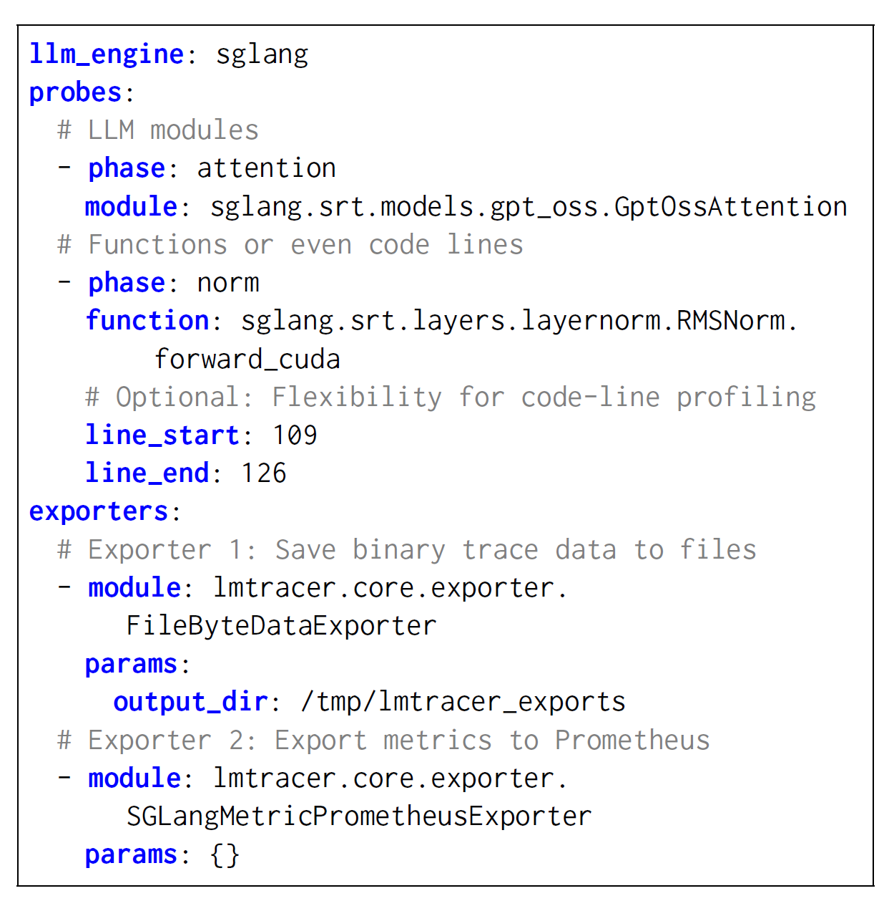
3. Design of LMTracer
LMTracer: Profiling configuration
Select the LLM framework/engines:
SGLang, vLLM, Megatron-LM, or others
Specify what to profile:
LLM modules/layers, functions, code regions
Choose where to export:
Trace files or monitoring systems
Notes:
It starts with a profiling configuration.
First, developers can choose the framework to be launched with[点击1], such as vLLM, SGLang, or Megatron-LM. Then, they can specify what to profile[点击2]. This could be a model layer, a function, or a particular code region, such as attention or MLP. Finally, choose where to send the results, for example, a trace file or a monitoring system[点击3].
Users describe what they want to measure in terms of their code. LMTracer then handles how those regions map to GPU execution.

Slide 12
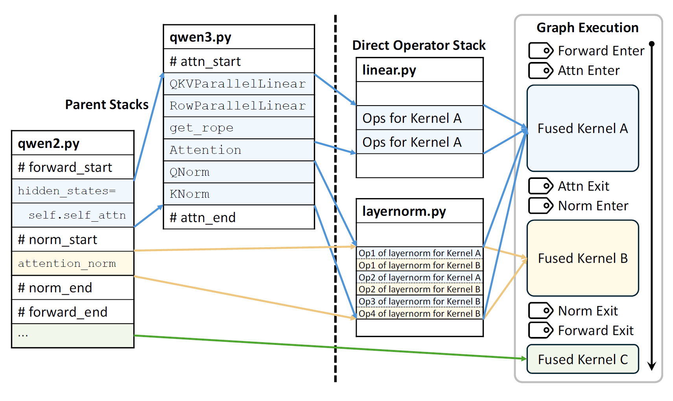
3. Design of LMTracer
LMTracer: Stack-aware compilation
  Mapping user-defined trace points to probe kernels
  Preserve kernel fusion and graph execution
Notes:
After LMTracer receives the profiling configuration, and as the LLM service starts up, LMTracer maps the selected code regions to probe kernels.
But this mapping is not straightforward. During compilation, several operators may be fused into one GPU kernel, so we cannot simply insert a probe at every source-code boundary.
To handle this, we use stack-aware compilation. We follow the operators’ call stacks to identify which code regions they belong to, then place probes at the corresponding fused-kernel boundaries. This lets us preserve kernel fusion and graph execution. Let me show you an example.

Slide 13
3. Design of LMTracer
Denotes a
probe kernel
LMTracer: Stack-aware compilation
Graph Execution
Direct Operator Stack
Forward Enter
qwen3.py
QKVParallelLinear
RowParallelLinear
get_rope
Attention
QNorm
KNorm
Attn Enter
# attn_start
linear.py
Ops for Kernel A
Ops for Kernel A
Fused Kernel A
Parent Stacks
qwen2.py
hidden_states=
self.self_attn
attention_norm
…
# forward_start
Attn Exit
Norm Enter
layernorm.py
Op1 of layernorm for Kernel A
Op1 of layernorm for Kernel B
Op2 of layernorm for Kernel A
Op2 of layernorm for Kernel B
Op3 of layernorm for Kernel B
Op4 of layernorm for Kernel B
Fused Kernel B
# norm_start
# attn_end
# norm_end
Norm Exit
# forward_end
Forward Exit
Fused Kernel C
Notes:
Here, suppose the developer wants to profile three regions: the forward pass [点击1], attention[点击2], and normalization[点击3]. These markers tell us where each region starts and ends in the source code.
When the LLM framework begins to compile a fused kernel, LMTracer recursively follows the operators’ static call stacks to find which user-defined profiling regions they belong to.
Let us take kernel A as an example [点击4]. Its operators come from linear.py and layernorm.py [点击5]. We then follow their parent call stacks [点击6–7] and find that kernel A belongs to the attention region [点击8]. So we place an attention-entry probe before it [点击9] to record the entry time of attention.
Following the stack further, we find that it also belongs to the forward pass [点击10], so we place a forward-entry probe at the same boundary [点击11].
Next, we move to kernel B [点击12]. Again, we look at its operators [点击13] and follow their parent call stacks [点击14].
We find that we have left the attention region [点击15], so we place an attention-exit probe before kernel B [点击16]. We have now entered the normalization region [点击17], so we also place a normalization-entry probe at this boundary [点击18].
Finally, we reach kernel C [点击19]. Its call stack shows that it is outside both regions [点击20]. We have left normalization [点击21], so we insert its exit probe [点击22]. We have also left the forward pass [点击23], so we insert a forward-exit probe here [点击24].
This way, we map the selected code regions to probe kernels while keeping kernel fusion intact.

Slide 14
3. Design of LMTracer
LMTracer: Doorbell-assisted shadow buffering
  To eliminate GPU-CPU synchronization:
Probe kernels write traces into GPU-side shadow buffers
A doorbell signals the CPU when a buffer is ready
Asynchronous transfers overlap with GPU execution
Current Buffer Pointer
GPU
Shadow Buffer A
Buffer Full
Shadow Buffer B
Doorbell Signal
Write
Pointer
GPU-CPU Mapped Memory
Async
Copy
Trigger
_threadfence_system
Trace Buffer
Poller Thread
CPU
Notes:
When running the probe kernels, we need to get that data back to the CPU for later analysis. But copying every record immediately would disturb GPU execution, while waiting until the end would delay visibility. To address this, we use doorbell-assisted shadow buffering.
[点击1]
We keep two shadow buffers on the GPU. The probe kernels write their records into the active buffer based on the write pointer[点击2].
When the active buffer fills up, we switch to the other buffer [点击3] and notify the CPU through a doorbell signal in mapped memory [点击4]. A background thread on the CPU watches for this notification.
[点击5]
Once the CPU sees the signal, the thread triggers an asynchronous copy on a separate GPU stream, without interfering the GPU-side execution.
In this way, we stream profiling data to the CPU in real time while keeping GPU execution uninterrupted.

Slide 15
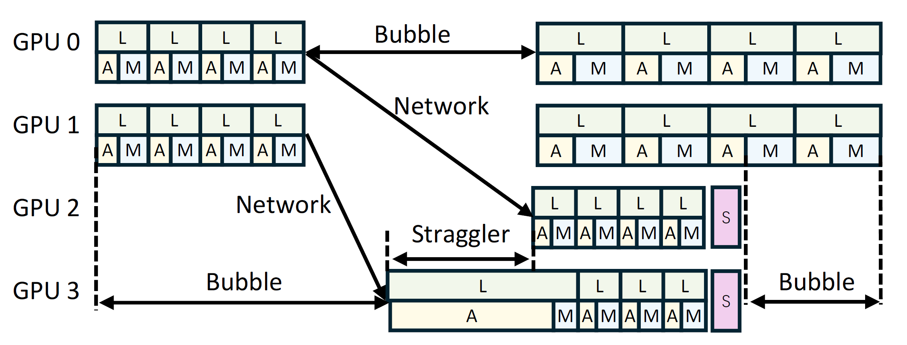
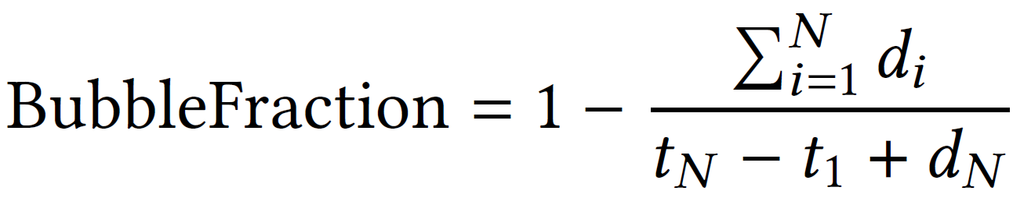
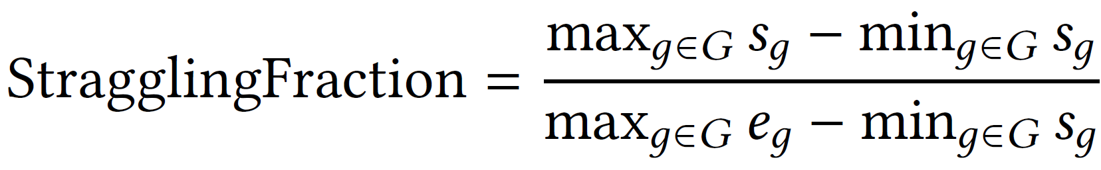
3. Design of LMTracer
LMTracer: Bottleneck analysis
  Reconstruct execution pipelines from gathered dependencies
  Compare corresponding operations across GPUs
  Identify GPU bubbles, stragglers, and communication delays
Notes:
With these traces, we use dependency information to reconstruct execution timelines across GPUs. We then use bubble fraction and straggling fraction to alert us to potential performance issues.

Slide 16
4. Evaluation
Evaluation setup
  Production deployment over eight months
  Serving: Qwen3-32B, DeepSeek-V3, and GPT-OSS-120B
  Training: DeepSeek-V3 fine-tuning on 256 GPUs
  LLM Frameworks: vLLM, SGLang, and Megatron-LM
  Baselines: Nsight Systems, Runtime Events, and PyTorch Profiler
Notes:
Now, let us look at the evaluation. LMTracer has been running in production for eight months, and our experiments use the same hardware and software configurations as the deployment.
For serving, we test Qwen3, DeepSeek-V3, and GPT-OSS using real user requests collected during peak hours. For training, we evaluate DeepSeek-V3 fine-tuning on over two hundred GPUs.
We compare LMTracer with Nsight Systems, runtime events, and PyTorch Profiler.

Slide 17
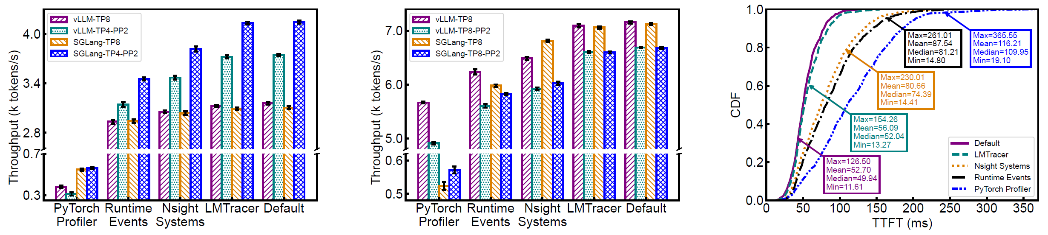
4. Evaluation
LMTracer introduces negligible profiling overhead
  Only 0.9%~1.5% throughput degradation across tested configurations
  Consistently lower overhead than existing profilers
Qwen3-32B Inference
DeepSeek V3 Inference
GPT-OSS-120B Inference
Notes:
Here are the serving results. LMTracer reduces Qwen3 throughput by just zero point nine percent and adds only three point four milliseconds to GPT-OSS’s average time to first token, while the other profilers cause much larger slowdowns, which limits their use for continuous profiling in production.

Slide 18
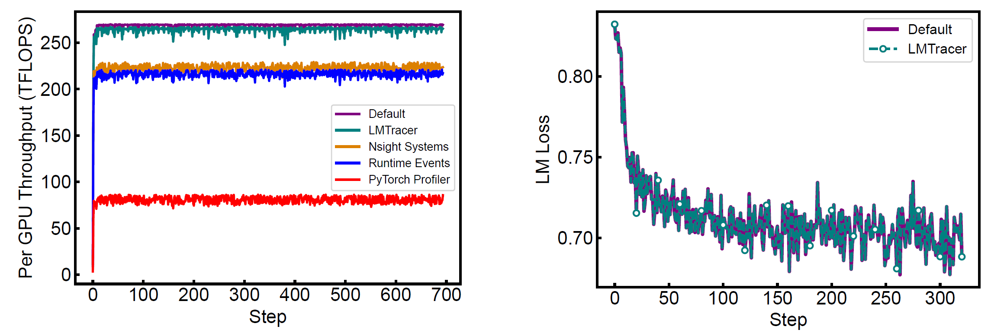
4. Evaluation
LMTracer introduces negligible profiling overhead
  Only 0.9%~1.5% throughput degradation across tested configurations
  Consistently lower overhead than existing profilers
DeepSeek-V3 Fine Tuning (Training)
Consistent Language Model Loss
Notes:
We see a similar trend in training. LMTracer reduces throughput by just one point five percent, compared with over seventeen percent for the other profilers. The loss curves with and without LMTracer almost overlap, indicating that it preserves training behavior.

Slide 19
4. Evaluation
Ablation study: contribution of each design
  Each design choice contributes to low profiling overhead
Throughput degradation (%)
Configuration
Serving
Training
LMTracer
0.9%
1.5%
Without probe merging
2.9%
3.0%
Without dual buffers
12.8%
5.7%
Without doorbell signals
16.2%
18.2%
Without asynchronous copy
13.3%
8.7%
Serving: Qwen3-32B on low-end GPUs
Training: DeepSeek-V3 SFT on high-end GPUs
Notes:
We performed an ablation study by disabling each design choice in turn to see its effect to the performance.
As you can see, removing any of these design choices increases profiling overhead. This shows that probe merging, shadow buffers, doorbell signals, and asynchronous copying all contribute to keeping LMTracer lightweight.

Slide 20
4. Evaluation
Profiling fidelity: linking kernels to user code
  Map compiled GPU kernels back to user-defined code regions
  Distinguish model operations hidden behind generic kernel names
Baseline: compiled kernel names
LMTracer: code locations and semantics
triton_red_fused__to_copy_add_
RMS normalization
mean_mul_pow_rsqrt_0
layernorm.py:127-148 (forward_native)
ampere_bf16_s1688gemm_bf16_
MLP up projection
128x64_sliced1x2_ldg8_f2f_tn
utils.py:70 (default_unquantized_gemm)
triton_poi_fused_mul_silu_1
SiLU activation
activation.py:77 (forward_native)
ampere_bf16_s1688gemm_bf16_
MLP down projection
128x64_sliced1x2_ldg8_f2f_tn
utils.py:70 (default_unquantized_gemm)
20
Notes:
Beyond low overhead, profiling results should be easy for developers to understand. The baseline shows kernel names that are hard to connect to model code.
On the right [点击], LMTracer maps them back to source locations and user-defined regions, showing which part of the model is taking time.

Slide 21
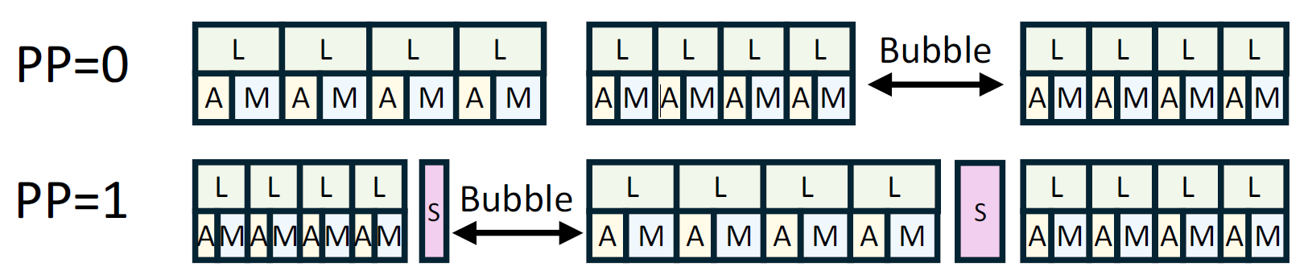
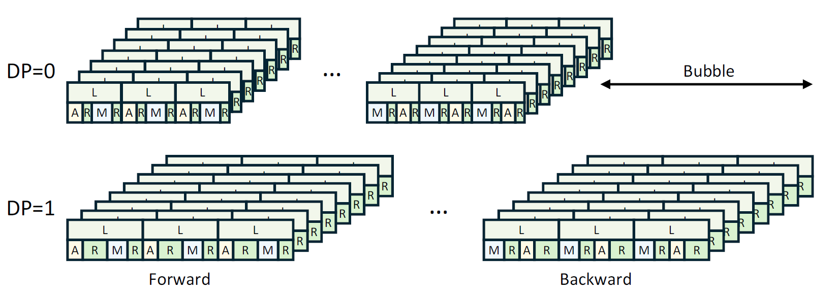
4. Evaluation
Case studies: diagnosing production bottlenecks
  Unbalanced scheduling in serving: uneven request execution times create pipeline bubbles
  NVLink issues in training: slow AllReduce operations in DP 1 stall the entire training job
High bubble fraction
High straggling fraction
21
Notes:
Here are two production issues identified with LMTracer.
In the upper figure, a high bubble fraction reveals idle time caused by unbalanced request scheduling.
[点击]
In the lower figure, an abnormal straggling fraction and long collective times lead us to NVLink errors on one host, which slow down the entire training job.

Slide 22

5. Conclusion
We identify the challenges of fine-grained, real-time profiling in production LLM systems, where existing tools either provide limited execution details or incur substantial overhead from CPU–GPU synchronization.
We present LMTracer, a performance profiling framework that combines graph-embedded probing with doorbell-assisted shadow buffering to capture GPU execution at user-defined code regions with minimal overhead.
We have deployed LMTracer in production for eight months, identifying 15 performance issues across LLM training and serving. After fixing these issues, we observed 21.2% lower serving latency and 24.5% higher throughput.
Code and data are released at https://llm-profiling.github.io/
Thanks!
Q & A
Notes:
So let me conclude our work.
We identified why existing profiling tools struggle with production LLM workloads. They either provide limited detail or disturb asynchronous GPU execution.
With LMTracer, we embed lightweight probe kernels into execution graphs and collect traces asynchronously, enabling fine-grained, real-time profiling with minimal overhead.
Over eight months in production, LMTracer helped identify fifteen performance issues. After fixing them, we observed twenty one point two percent lower serving latency and twenty four point five percent higher training throughput.
The code and data are available through the link and QR code on this slide. Thank you for listening. I’m happy to take questions.

